Slide 1
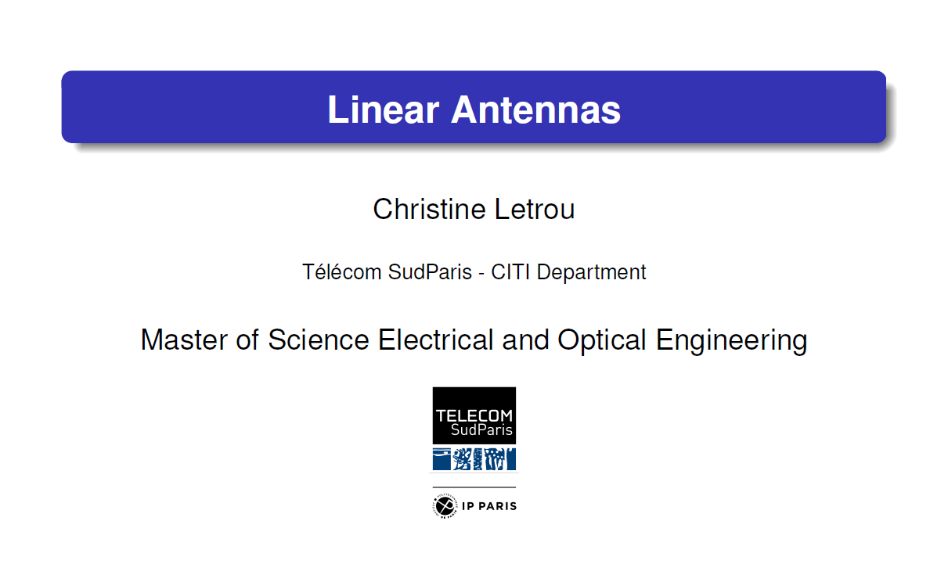
MASTER OF ELECTRICAL ENGINEERING FOR COMMUNICATIONS & INFORMATION PROCESSING
Radio Frequency for Connected Objects
Project: INDOOR POSITIONING WITH WiFi
By
Areeb Tariq
Muhammed Fatih Koc
Ahmed Waheed
Karthik Pandey
Date: 24 June 2021

Slide 2
Agenda
Background and Introduction
Motivation
Model Space, Nomenclature, Validity
Positioning Process Flow
Activity Timeline
Key Challenges and Solutions
Algorithm
Results
Observations and Remarks
Limitations
Future Variations
Software Tools

Slide 3
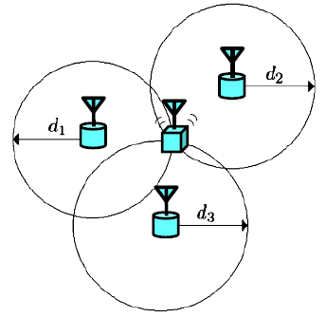
Background and Introduction
Indoor Positioning through WiFi
RSS based trilateration combinations method
WiFi propagation model
P(d) _{(dBm)} = P (d0) _{(dBm)} – 10*n_{sf}*log (d/d0) + FAF _{(dB)}
Simulataneous equations to find the estimated XY coordinates

Slide 4
Motivation
Relatively Inaccurate and Challenging approach
Room for try new methods
Different approach from other groups

Slide 5
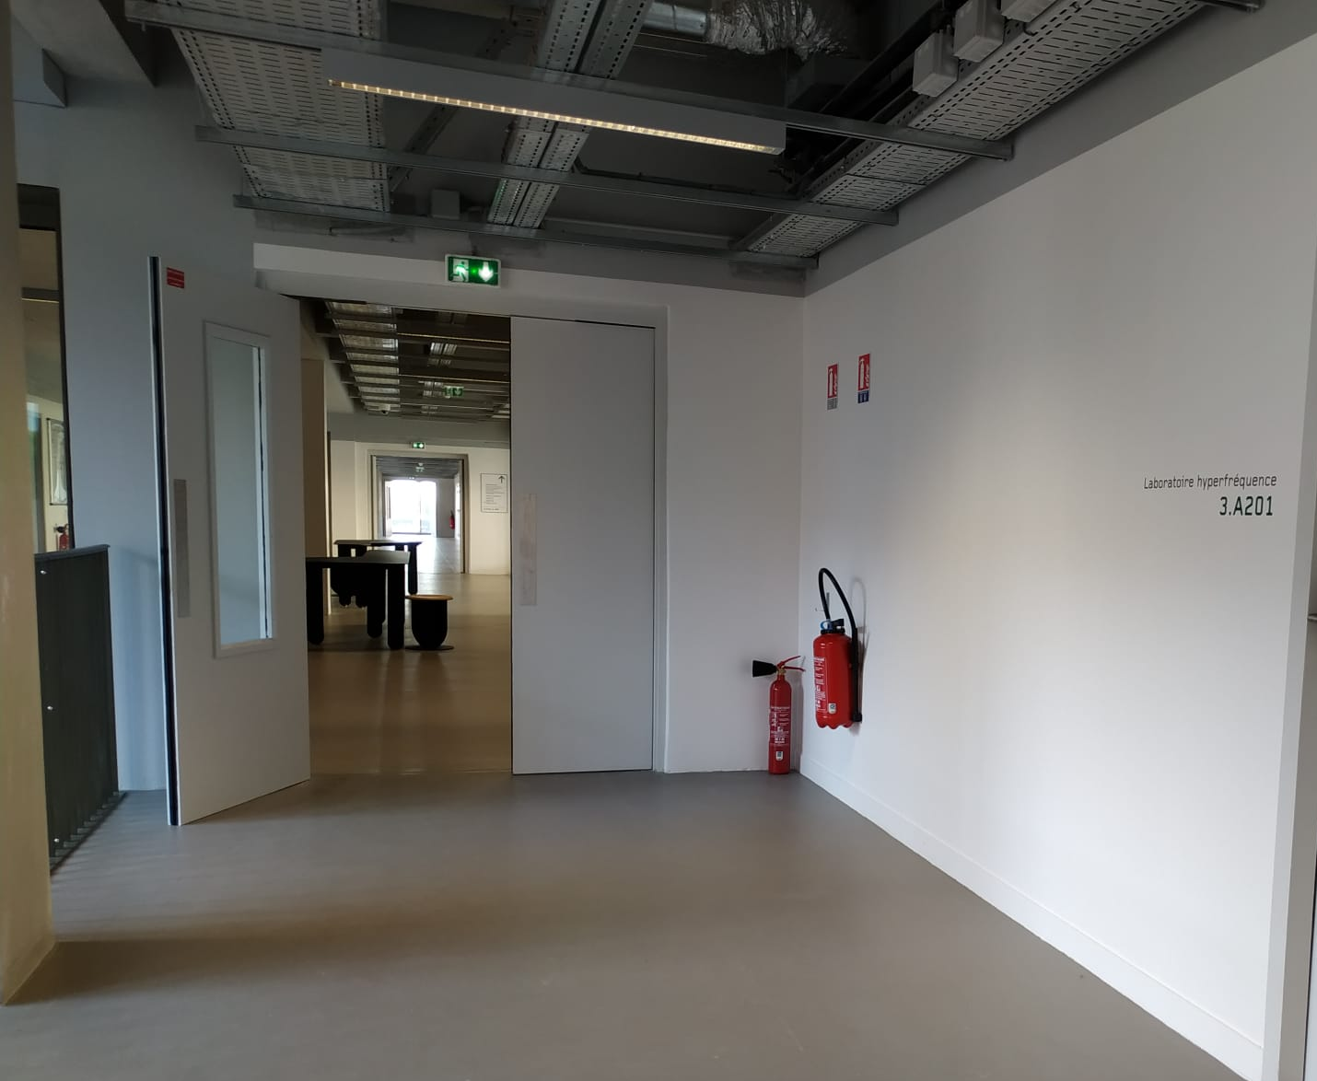
Proposed Model Space
3rd floor A-block of Telecom SudParis Palaiseau, France
Reference origin

Slide 6
Nomenclature of the Project
AP = Access point
MP = Measuring/test point
2nd Floor = A
3rd Floor = B
4th Floor = C
Labelling of routers counterclockwise (numerical)
Labelling of sides of floor counterclockwise (alpha, beta, gamma, delta)
“Blind Region”

Slide 7
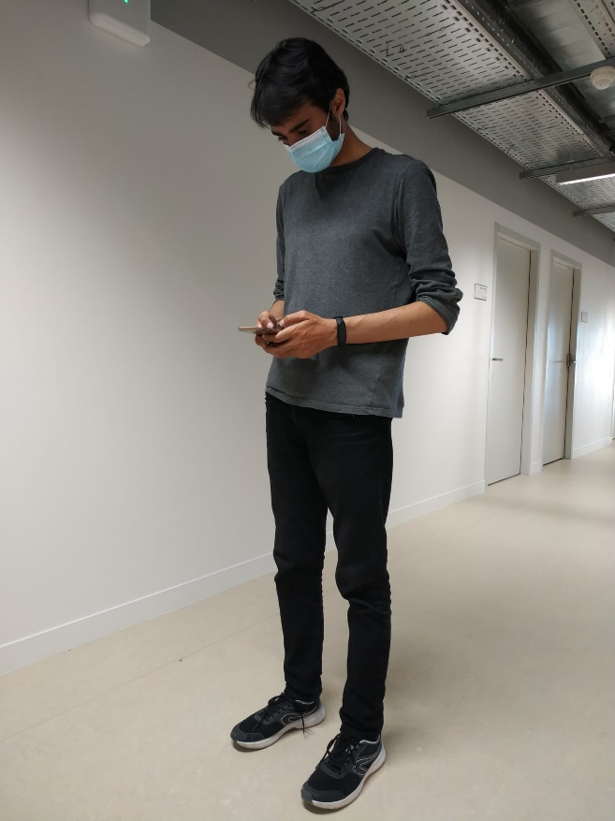
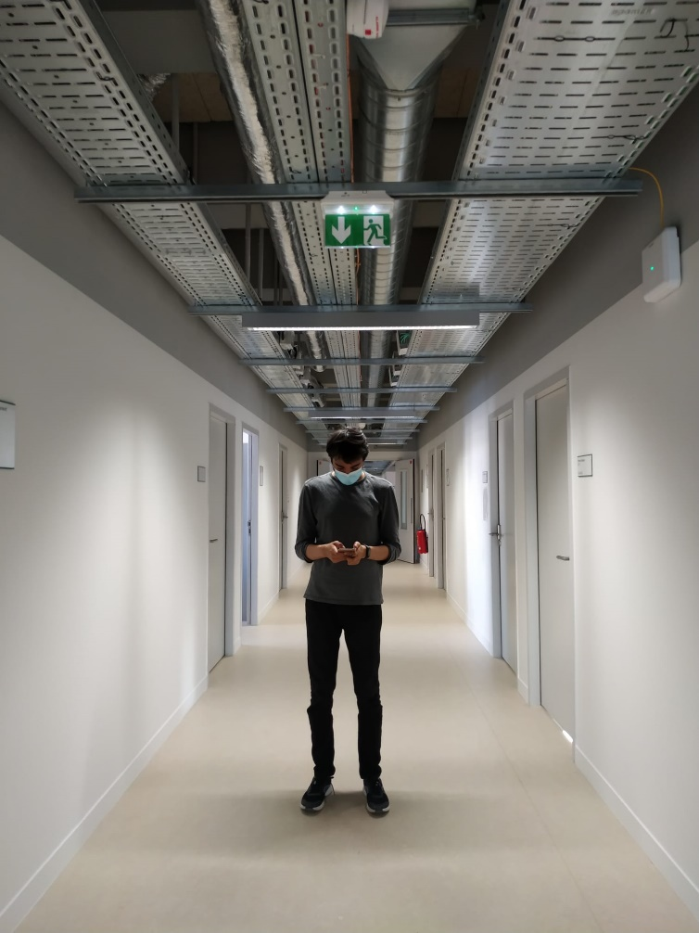
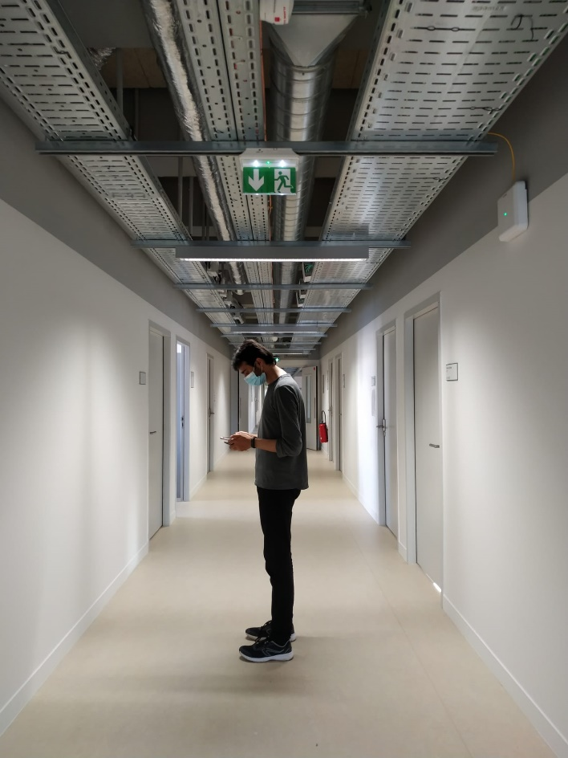
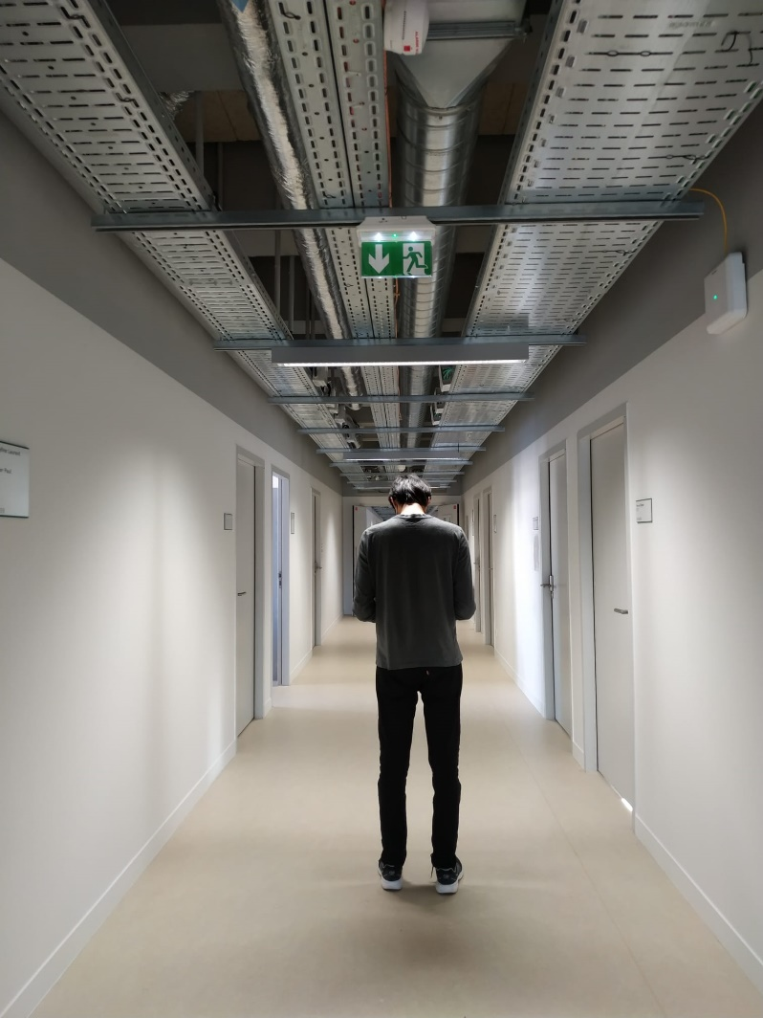
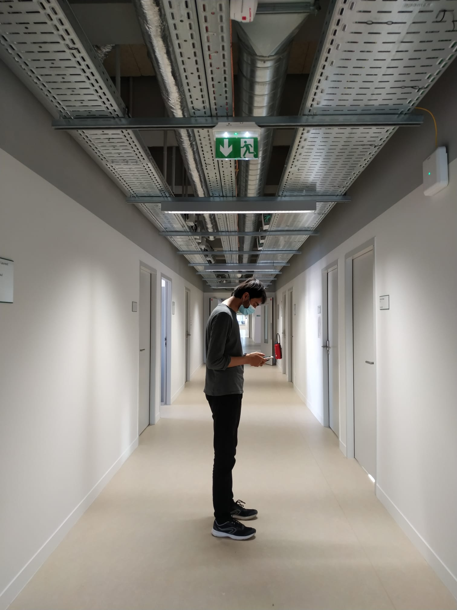
Validity of the Model
Corridors
Less accurate in “Blind region”
Horizontal static alignment of the mobile device
Measurement in all four directions
Long-term maintenance needed
FAF assumption = 25 dBm

Slide 8
Experimental Setup (1)
Measuring points (MP) | 20
Average distance between MPs | 7.5m
Identification of AP | Through MAC address
Access Point | 17
Average number of APs for one MP | 4.55
Total N_{sf} evaluated | 153
N_{sf}/AP | 36
Total optimum Nsf evaluated | 17
Number of power measurements for n_{sf} | 612
Number of overall power measurements | 573
Power measurements/MP | 28.65
Model Space area | 420 squares meters
Total lateration combinations | 200
Combinations/MP | 10
Measuring Instrument | Digital Distance meter, Measuring tape
Instrument mounting | Vertical Phone Holder

Slide 9
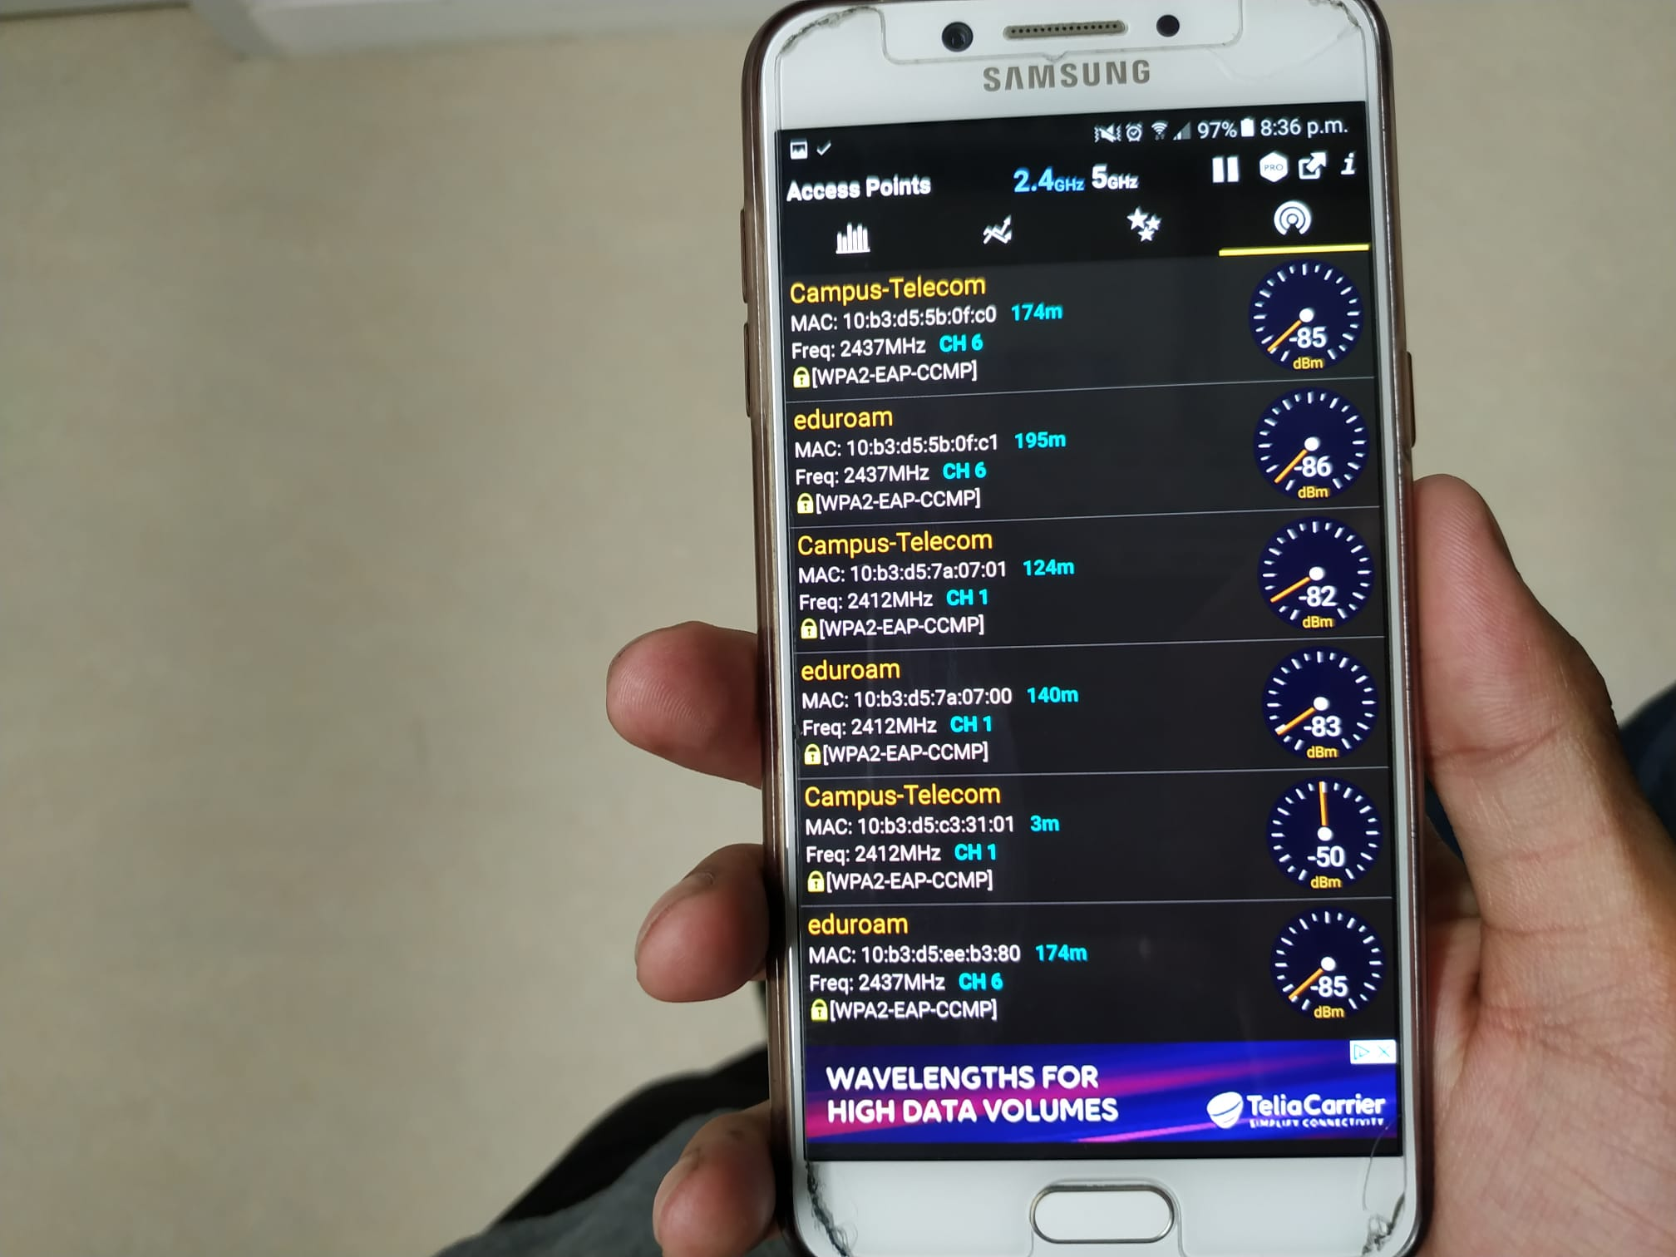
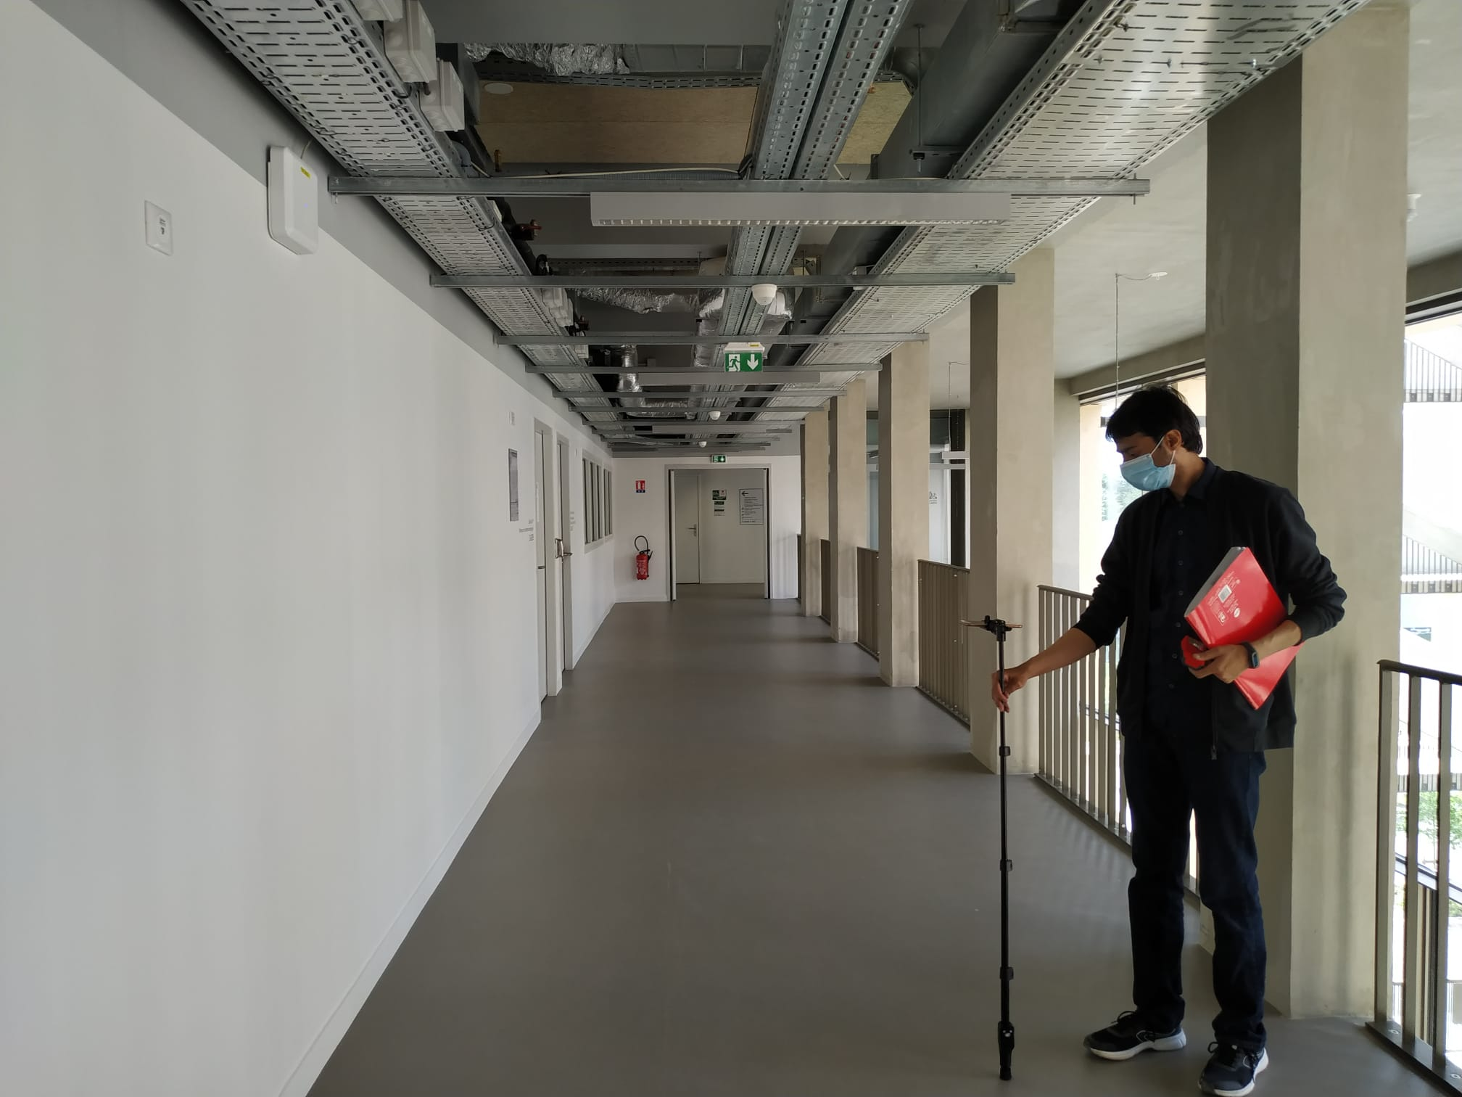
Experimental Setup (2)

Slide 10
Positioning Process flow
Database
Mobile Device with Positioning Application
Access to WiFi API
Application’s Processing Unit
Estimation of location

Slide 11
Activity Timeline
Observation of power and distance relationship
Defining reference origin and coordinate system
Labelling XYZ coordinates of APs on 3rd floor
Limited APs on 3rd floor
Proposition of Model and Algorithm
Compensation for LOS and NLOS effects
Optimization of path loss exponent
Evaluation of path loss exponent
Model for “Blind Region”
Automate process through C-code and Excel
Evaluation of results

Slide 12
Key Challenges
Limited Access Points (APs) at the model space
Inconsistency in path loss exponent (nsf) values
Impact of Line of Sight (LOS) and Non-line of Sight (NLOS) power measurements
Blind Regions (availability of less than 3 APs)

Slide 13
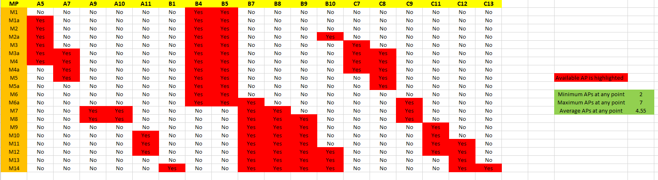
Solutions (1)
Limited Access Points (APs) at the model space
Adding 2 more floors (Average 2.7 APs vs 4.55 APs)

Slide 14
Solutions (2)
Inconsistency in path loss exponent (nsf) values
Optimization of nsf
2 d0 points for each AP
Mark 7 ‘d’ points at
7m, 12m, 15m, 17m, 23m, 25m, and 29m
Total of 9 measuring points (6 on one side, 3 on other)
Measure power levels at each point in all four directions
Find error for each nsf
Total 14 nsf for one AP
Calculate nsf for each ‘d’ vs each ‘d0’
Total 9 x 4 power measurements
Pick one best nsf
14

Slide 15
Solutions (3)
Inconsistency in path loss exponent (nsf) values
Optimization of nsf
Nsf Power measurements per AP = 36
Nsf per AP = 14
Total nsf power measurement for all APs = 36 x17 = 612
Total nsf for all APs = 17 x 14 = 238

Slide 16
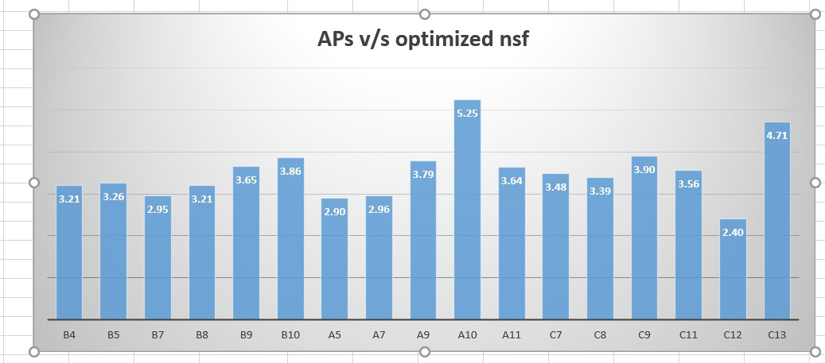
Solutions (4)

Slide 17
Solutions (5)
Impact of Line of Sight (LOS) and Non-line of Sight (NLOS) power measurements
Measured power in all four directions. Validity for the model assumes same
Followed by the median value (rejects extreme and outliers values)

Slide 18
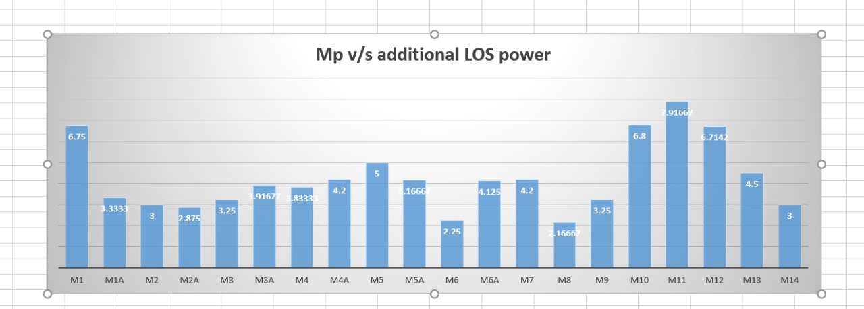
Solutions (6)
Impact of Line of Sight (LOS) and Non-line of Sight (NLOS) power measurements
In 573 measurements:
average LOS = 4.36 dBM higher than median value

Slide 19
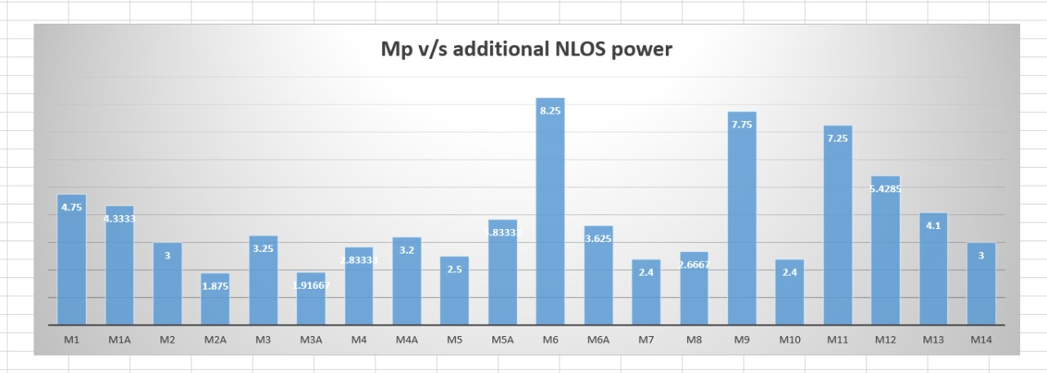
Solutions (7)
Impact of Line of Sight (LOS) and Non-line of Sight (NLOS) power measurements
In 573 measurements:
average NLOS = 3.76 dBM less than median value

Slide 20
Solutions (7)
Blind Regions (availability of less than 3 APs)
“No information is an information itself”
Corners of the corridors
Intuitive reasoning
Example: Point M1: B4 = -71dBm, B5 = -80.5dBm, and no other AP
Only one region satisfies these conditions:
B4 and B5 exist
B4 > B5
No other AP exists

Slide 21
Algorithm(1)
Record power measurements in all four (North-South-East-West) directions
Two timers T1 (initial timer) and T2 (max record timer)
Search observed AP into database with their MAC addresses
If there are no available AP, give error to the user
Else, find the median of all power levels recorded against the AP
If there is one known AP, make circle centered at AP with radius = distance (from propagation equation). This is possible region
If there are two known APs, propose “Blind region” approach
If there are three or more, make all combinations of 3

Slide 22
Algorithm(2)
For each combination, using simultaneous equations, estimate XY coordinates of the user.
For N combinations, N XY estimated positions.
Find median of XY value. This is the final estimated XY position

Slide 23
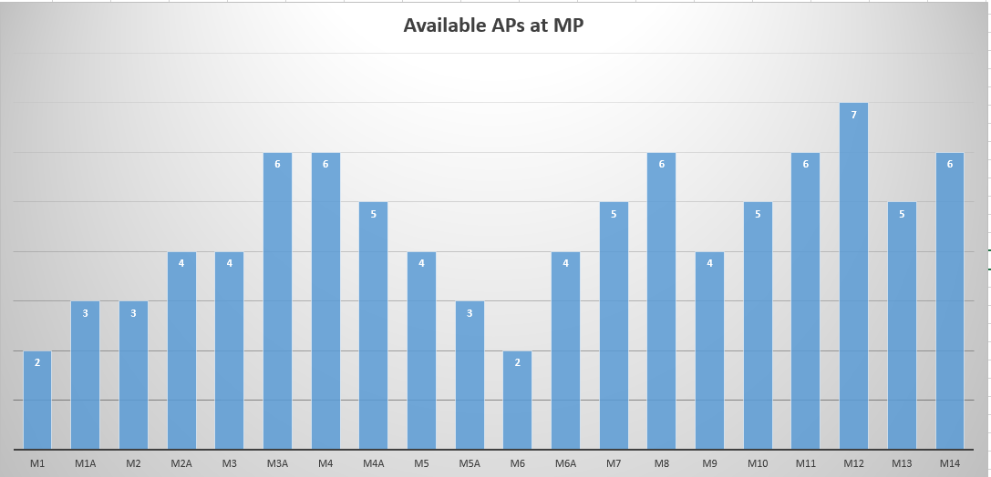
Results (1)

Slide 24
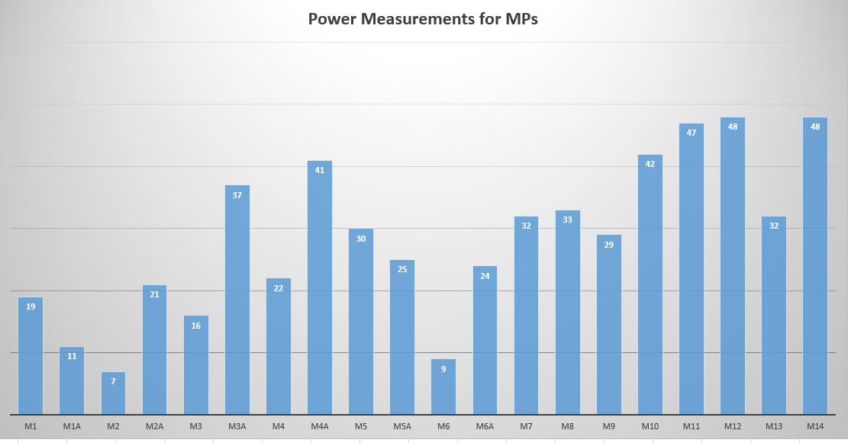
Results (2)

Slide 25
Results (3)

Slide 26
Results (4)

Slide 27
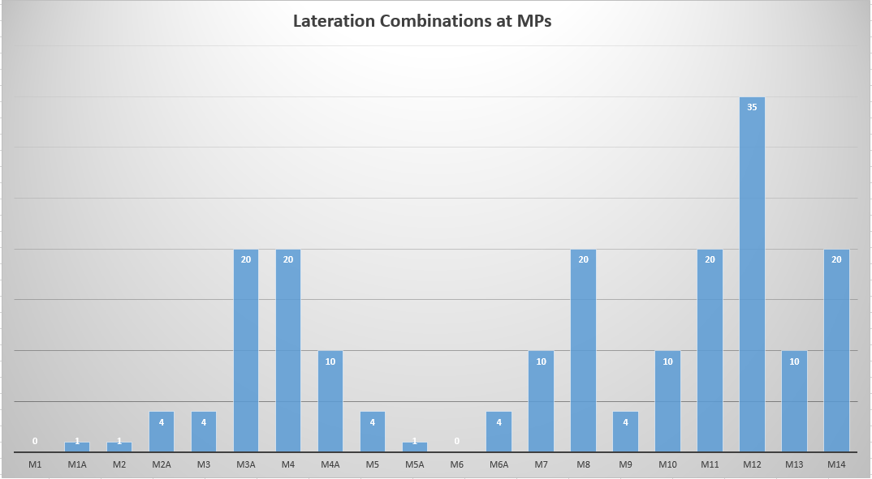
Results (5)

Slide 28
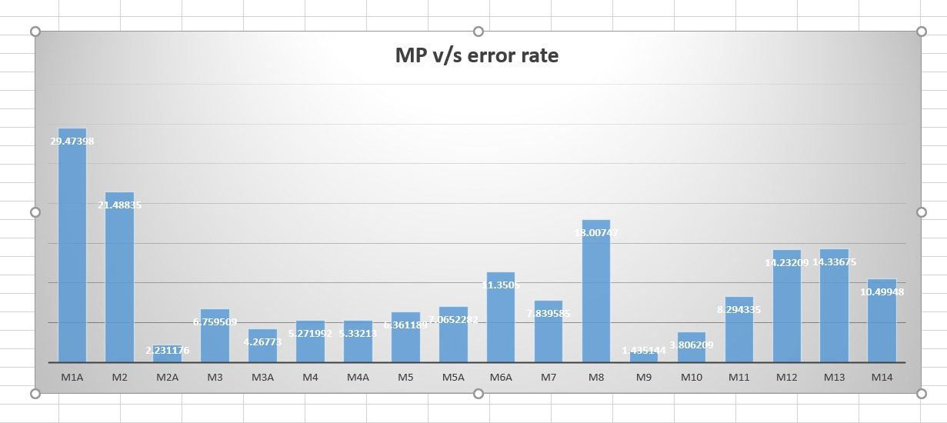
Results (6)

Slide 29
Results (7)

Slide 30
Results (8)

Slide 31
Observations and Comments
Increasing the number of combinations for laterations increases the performance till a threshold point (10-20 combinations)
Beyond the point, performance falls (low power APs affect)
Least accuracy with points with just 1 combination of APs
Higher nsf value for a weak router and vice versa
Practically, the antenna is not omnidirectional in horizontal plane
Orientation of body (LOS/NLOS) and elevation of hand drastically affect the results (our solution)
Nsf optimization is core part for the WiFi propagation modeling
The initial time measurements in mobile application are corrupted/old and need time for updates (our solution: timers)

Slide 32
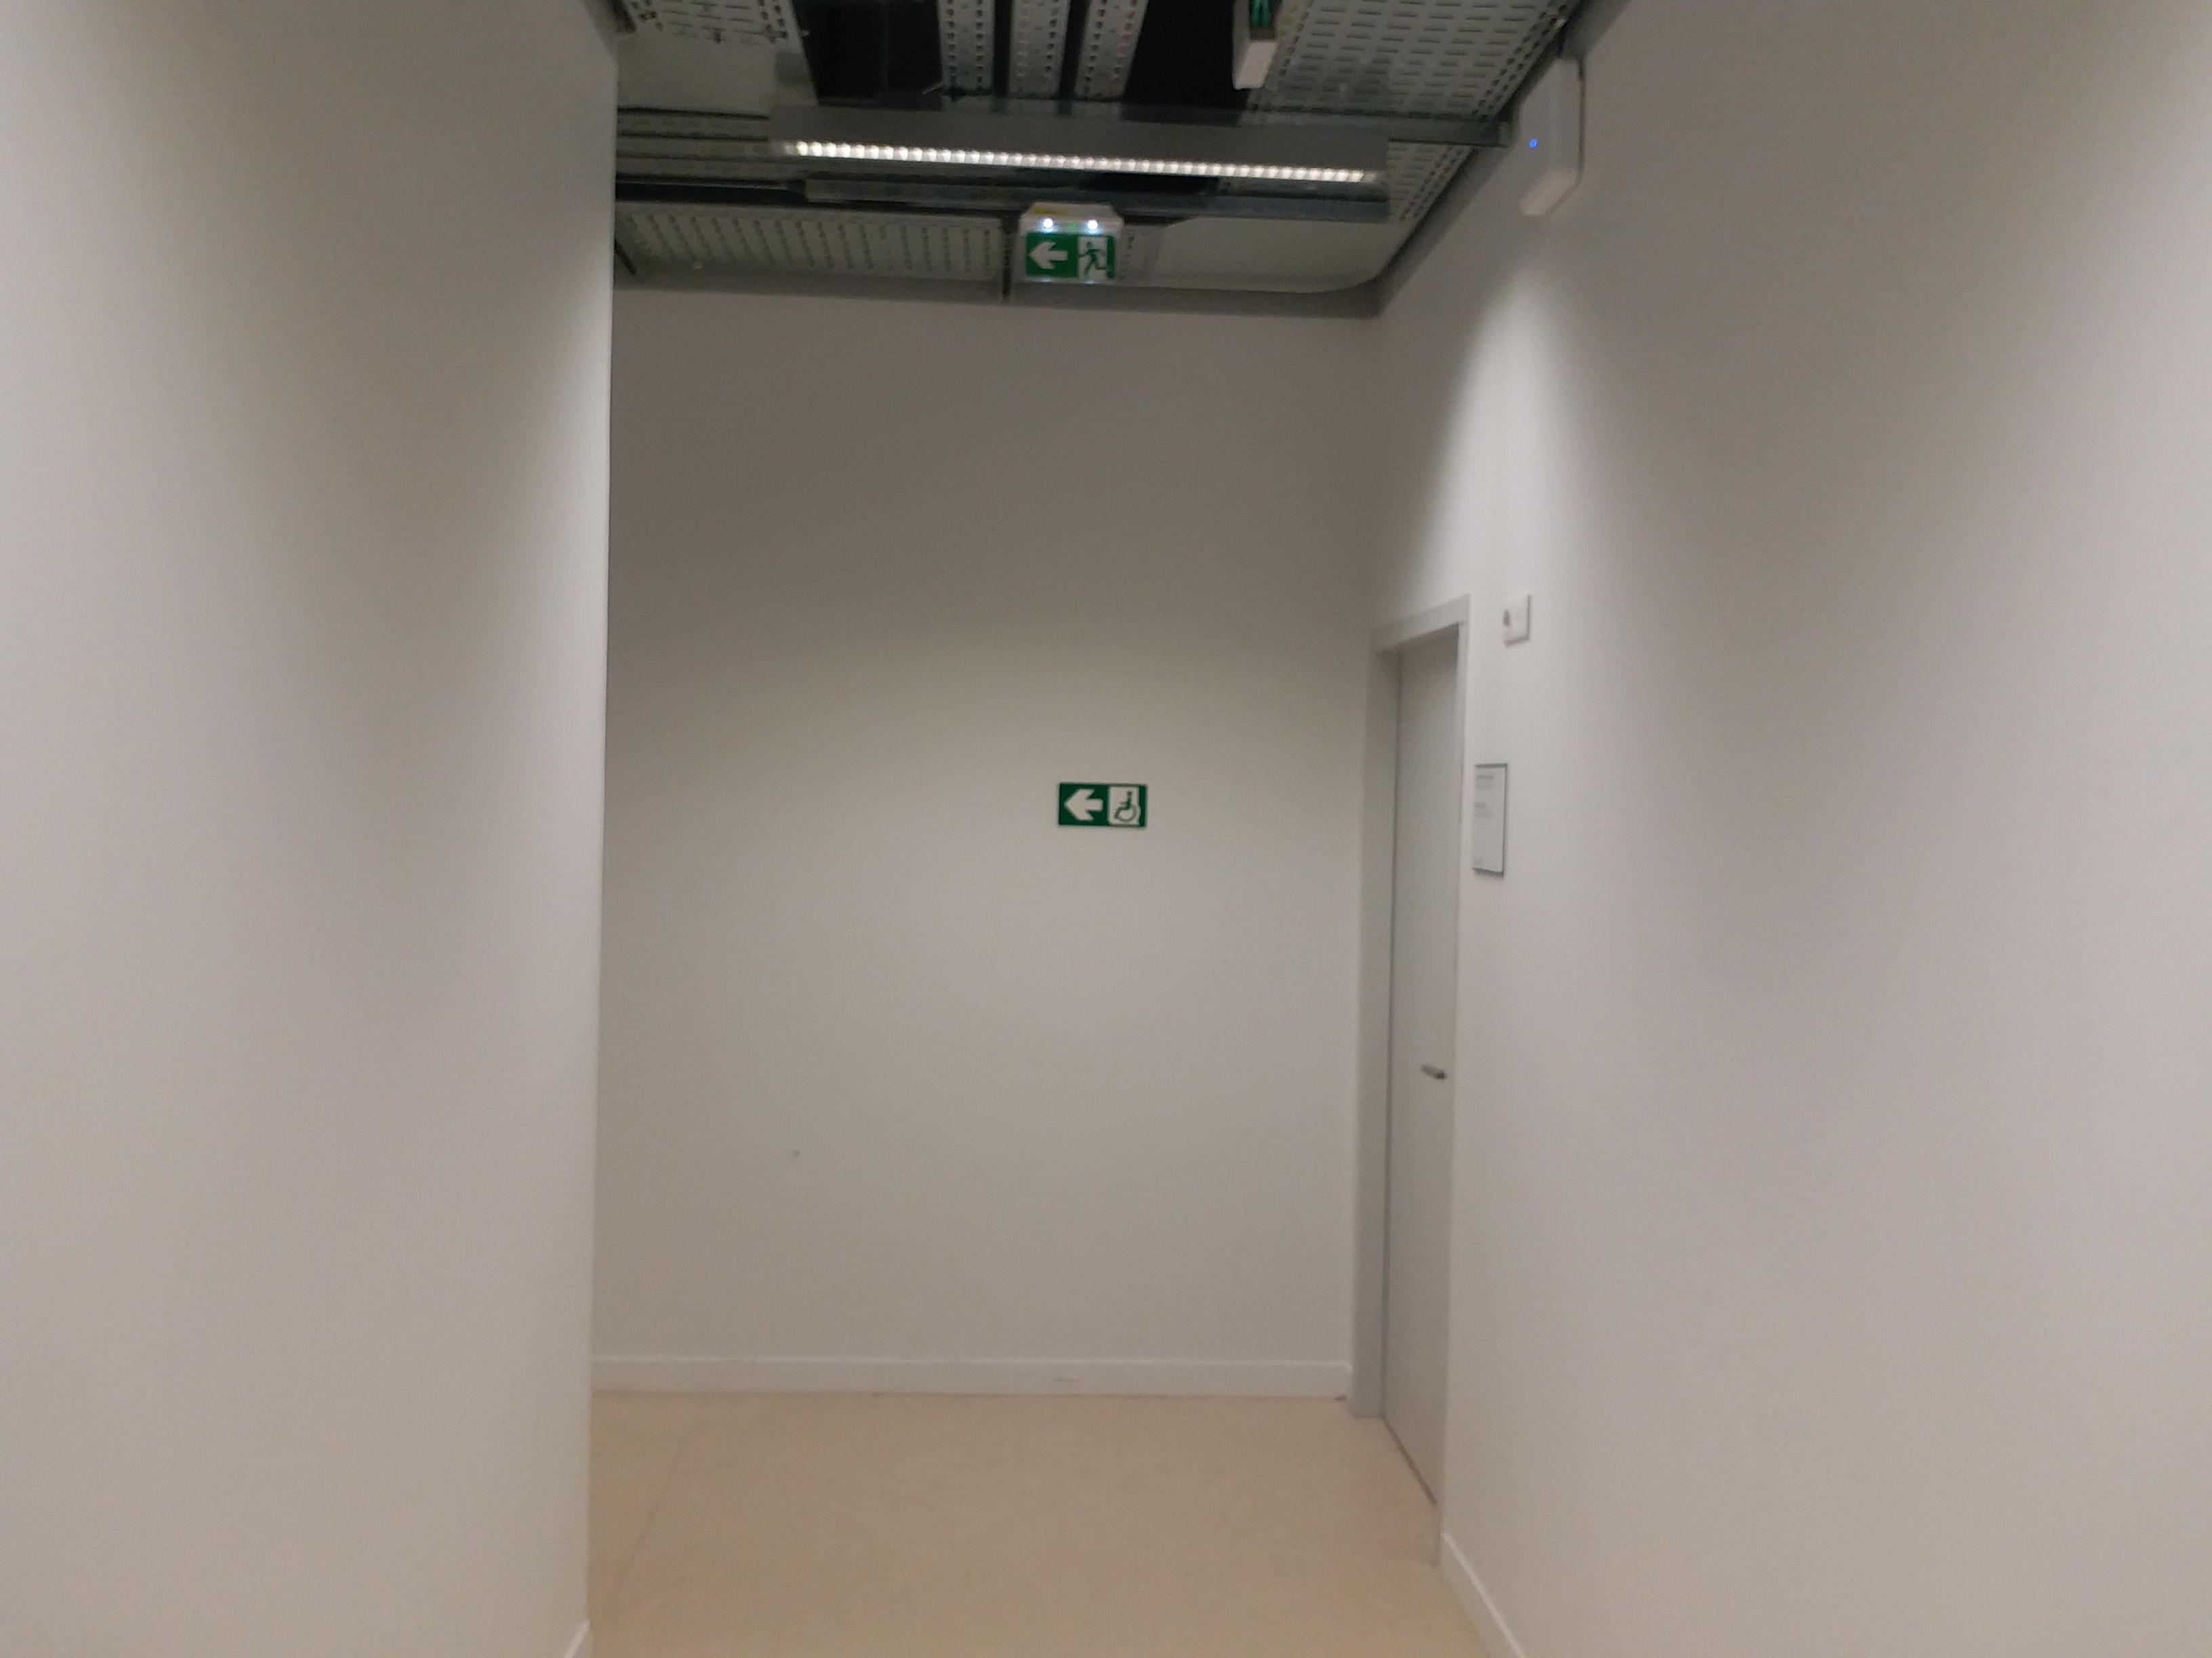
Observations and Comments
Case of AP: A10
Highest nsf recorded = 5.25
Strong obstacles (wall) attenuates equivalent to the floor attenuation

Slide 33
Limitations
For future, a maintenance service needed for the optimization of the nsf.
This model doesn’t implement other important factors in propagation (like FAF)
Not an optimum evaluation of data quality (simple usage of median)

Slide 34
Future Recommendations
Can be extended to other floors
Can be extended to find the 3d coordinates
Can be added with the feature of finding the route by entering the destination point (i.e. room no).
We can employ UWB for accurate mapping of XY coordinates in indoor space (Reference)
Can be used with Inertial Sensors in Fusion for better accuracy especially indoor
Can be modeled with better statistical models to evaluate quality of data (power measurements)

Slide 35
Software Tools
Excel file (Project_DataSheet): AP and MP database, with automatic formulae
Excel file (Evaluation_and_Optimization_of_nsf): Data for the nsf calculation and optimization
C++ (RF_Project): User friendly software with input power levels and MAC. And provide simultaneous equations
All these tools are provided with ReadMe files for user to assist in using these applications

